Slide 1
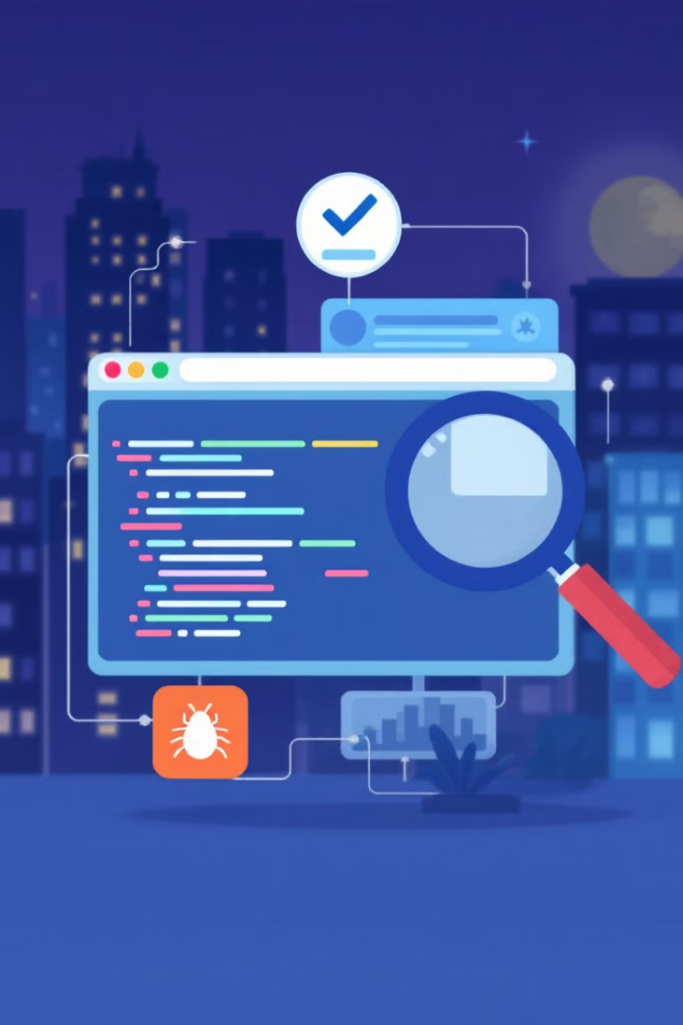

Software Testing Fundamentals
A comprehensive guide to software testing basics for beginners
by Ugochukwu Anajemba

Slide 2




What is Software Testing?
Process
Verification
Assurance
Evaluates software to detect defects
Ensures software meets requirements
Confirms product is fit for use

Slide 3




Why Testing Matters
User Satisfaction
1
Reliable software builds trust
Security & Compliance
2
Protects data and meets regulations
Cost Efficiency
3
Early detection saves money
Quality Assurance
4
Reliable, functional products

Slide 4
Common Testing Misconceptions
Myth: Guarantees Bug-Free
Myth: Only Final Phase
Myth: Same as Debugging
Testing reduces defects but can't eliminate all
Should integrate throughout development cycle
Testing finds issues; debugging fixes them

Slide 5

Testing Principles
1
Shows Defect Presence
2
Exhaustive Testing Impossible
Not their absence
Strategic approach required
3
Early Testing Saves Resources
4
80/20 Rule Applies
Catches issues when cheaper to fix
Most defects in minority of modules

Slide 6
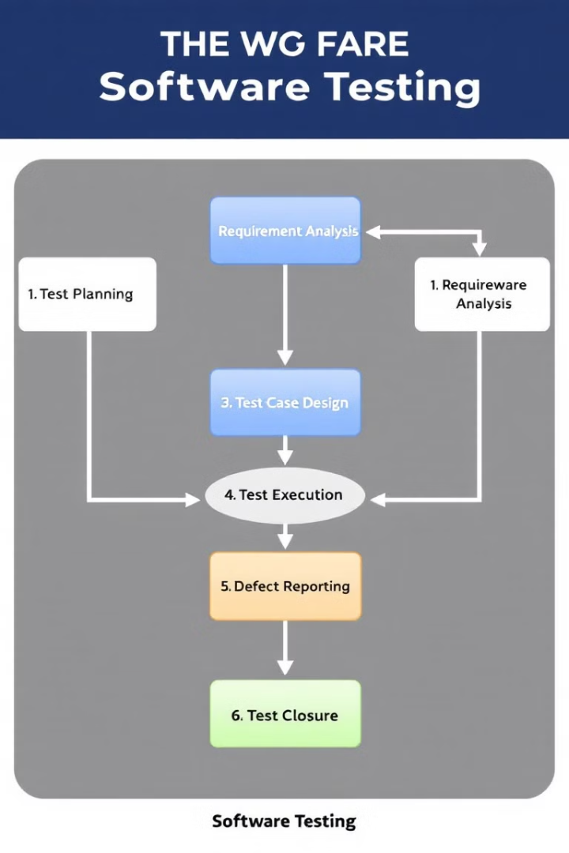




Testing Process Flow
Planning
Define scope, objectives, strategy
Analysis & Design
Create test conditions and cases
Implementation & Execution
Run the tests
Completion
Report results and document findings

Slide 7
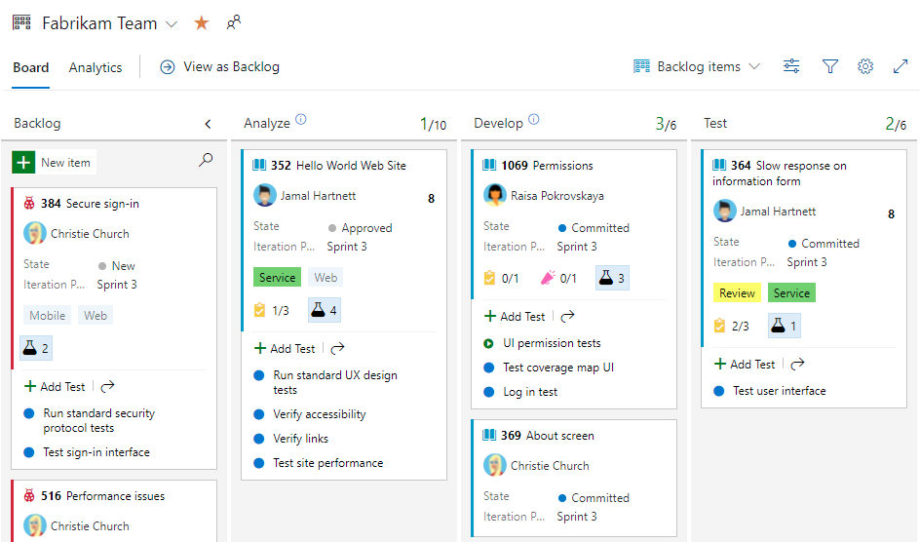

Slide 8
Testing Levels
Acceptance Testing
1
Meets business needs
System Testing
2
Complete system evaluation
Integration Testing
3
Component interactions
Unit Testing
4
Individual components

Slide 9





Testing Types
2
Non-Functional
Functional
How well it performs
1
What the system does
Static
3
Without execution
Regression
5
Dynamic
Impact on existing features
4
With execution

Slide 10
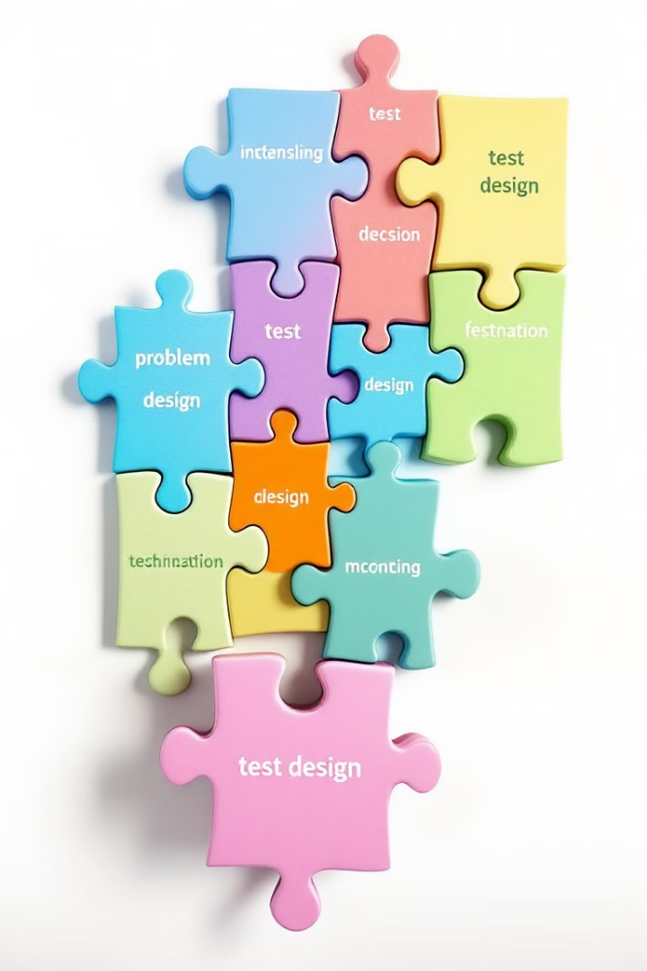
Test Design Techniques
Black-Box
White-Box
Based on inputs/outputs without seeing code
Based on internal structure and logic
Equivalence partitioning
Statement coverage
Boundary value analysis
Branch coverage
Experience-Based
Uses tester's knowledge
Error guessing
Exploratory testing

Slide 11
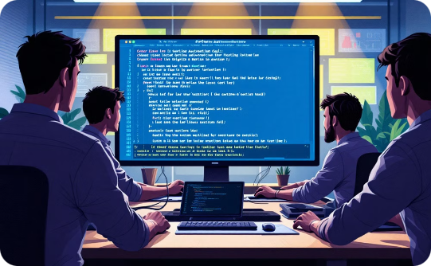
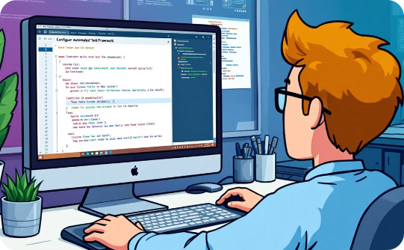
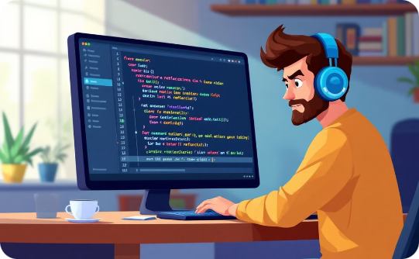
Test Automation
Tools
Benefits
Challenges
Selenium, JUnit, JMeter, TestRail
Speed, reusability, reliability
High initial cost, needs maintenance

